Slide 1
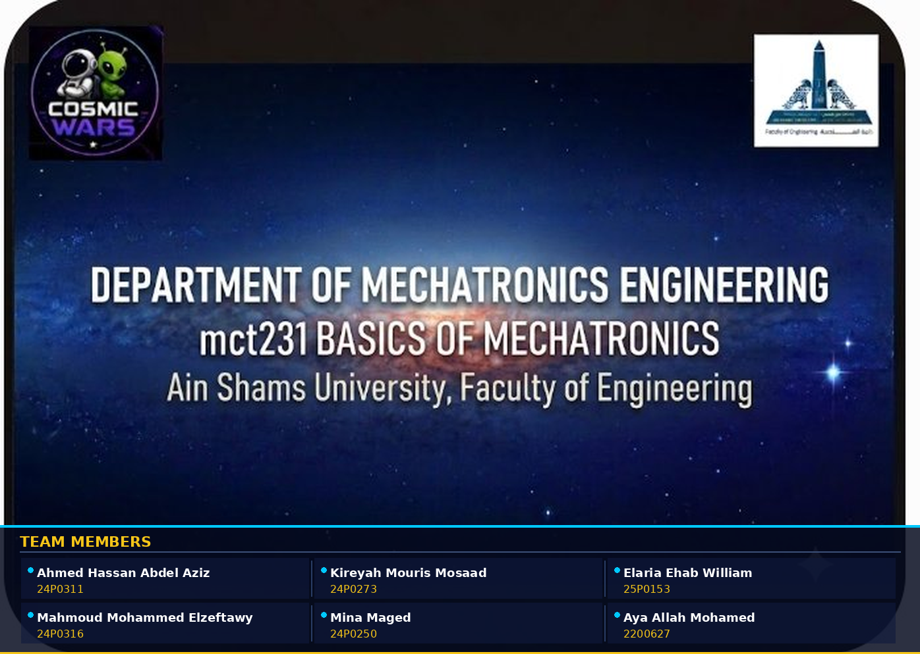

Slide 2
PROJECT OVERVIEW
What is Cosmic Wars?
Cosmic Wars is an interactive, space-themed mechatronics game that combines physical engineering with real-time decision-making. Players answer trivia questions to unlock ball shooters, scoring points by hitting targets with color-sorted balls — all controlled by Arduino.
🎮 Interactive Gameplay
🤖 Arduino-Powered
Joystick-controlled ball shooters for real-time play
Dual microcontrollers handle sensing & actuation
🔵 Color Sorting
🏆 Scoring System
Automated sorting of green & white balls via sensor
Left target 100pts, centre & right 50pts each

Slide 3
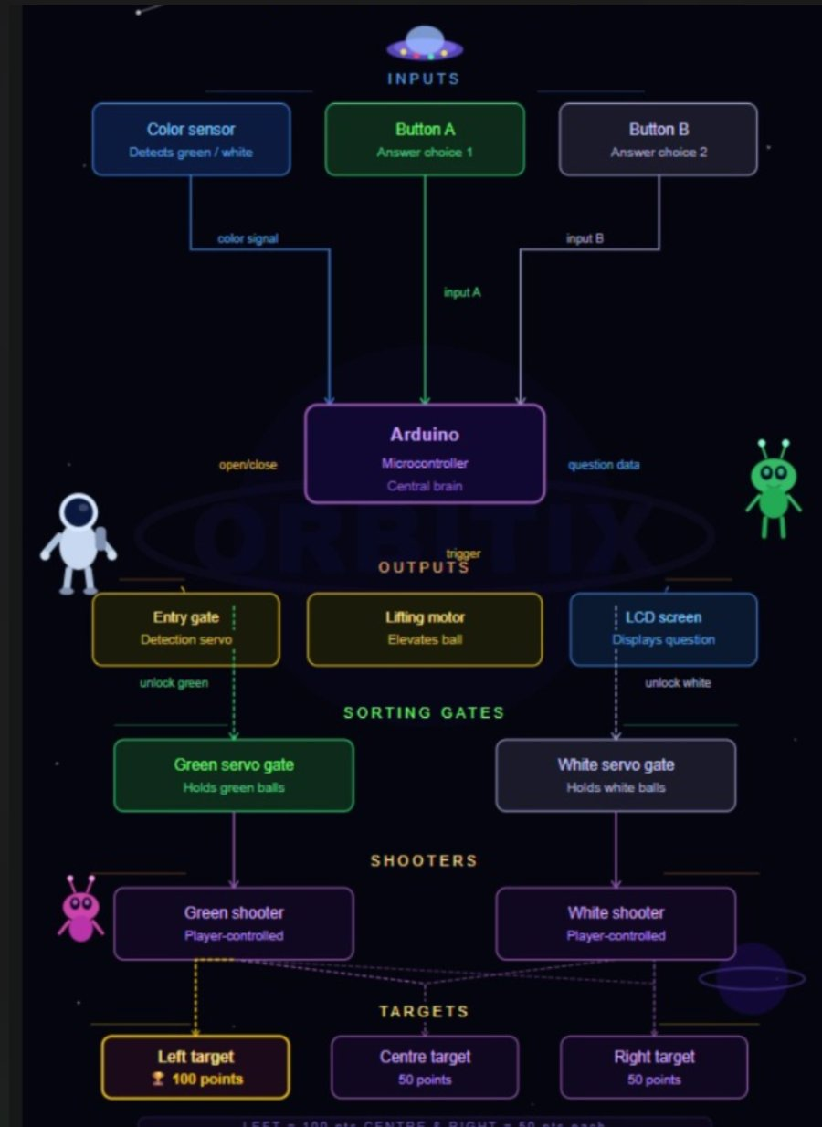
SYSTEM ARCHITECTURE
Block Diagram
Key Signals
Color signal
Sensor → Arduino
Input A / B
Buttons → Arduino
Open/Close
Arduino → Entry gate servo
Trigger
Arduino → Lifting motor
Question data
Arduino → LCD display
Unlock gates
Arduino → Sorting servos

Slide 4
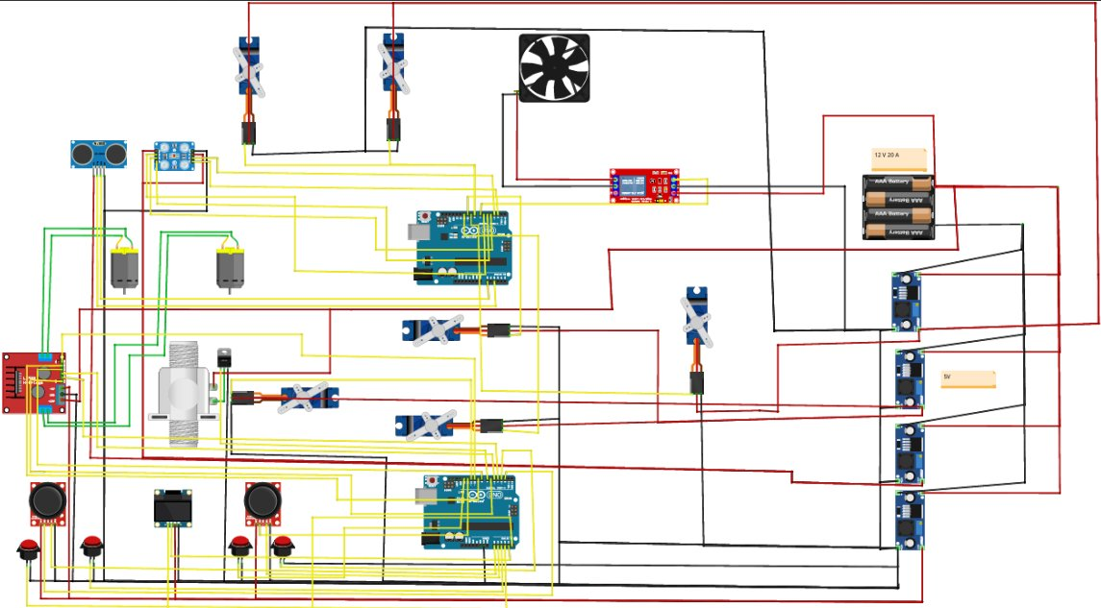
HARDWARE CONNECTIONS
Wiring Diagram
Power (12V/5V)
Ground (GND)
Signal / Data
Control Lines

Slide 5
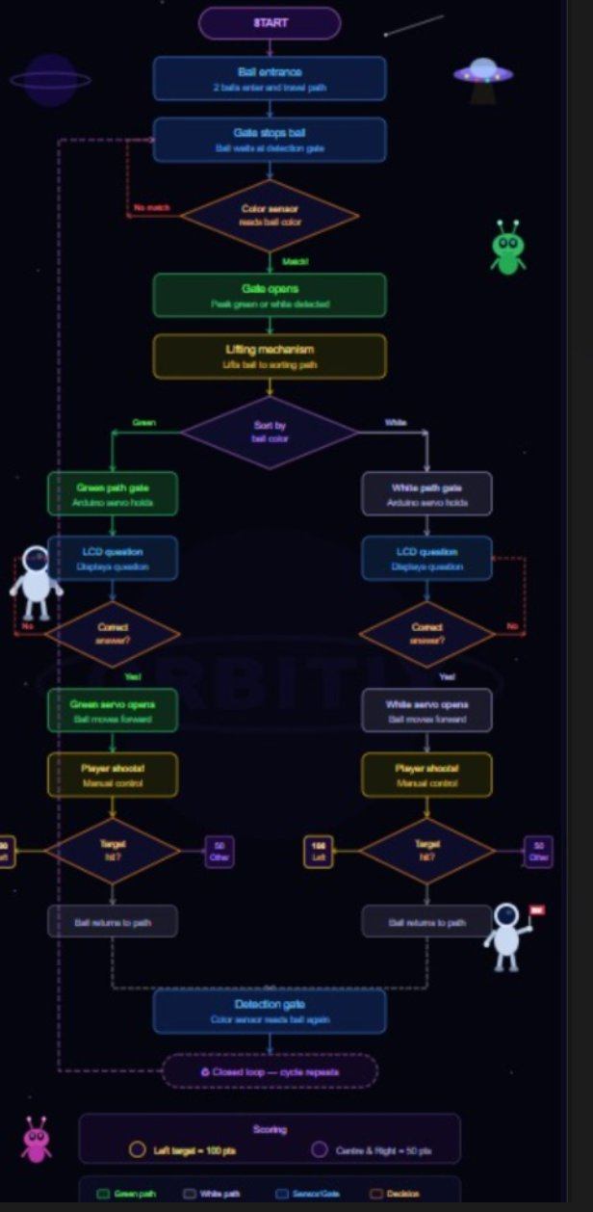
GAME LOGIC
System Flowchart
01
Ball Entry & Detection
2 balls enter the path. Color sensor reads ball at the detection gate.
02
Sorting by Color
Ball is lifted and routed to green or white path by Arduino servos.
03
Trivia Question
LCD displays question. Player presses Button A or B to answer.
04
Gate Unlock
Correct answer → servo gate opens, ball moves to shooter lane.
05
Player Shoots
Manual joystick control. Ball hits Left (100 pts) or other (50 pts).
06
Closed Loop Repeats
Ball returns to path, cycle restarts automatically.

Slide 6
HARDWARE SPECIFICATIONS
Components & Parts
Microcontrollers
Sensors & Inputs
Actuators
Power & Display
▸ 2× Arduino Uno
▸ Color sensor (green/white detection)
▸ 5× Servo motors (gates & shooter)
▸ 12V / 20A main supply
▸ Dual-board architecture
▸ 2× Joystick modules
▸ 2× DC motors
▸ 3× AAA battery pack (5V)
▸ Master + slave configuration
▸ 4× Push buttons (A/B per player)
▸ Lifting mechanism motor
▸ 4× Voltage regulators
▸ Cooling fan
▸ LCD display screen

Slide 7
GAMEPLAY
Scoring & Rules
LEFT TARGET
CENTRE TARGET
RIGHT TARGET
100
50
50
pts
pts
pts
Hardest to hit
Medium difficulty
Medium difficulty
Game Rules
🟢 Green balls go to the Green shooter lane
🎮 Use the joystick to aim and shoot the ball
⚪ White balls go to the White shooter lane
🔄 Balls automatically return to the path — closed loop
❓ Answer the trivia question before your gate opens
🏆 Highest score after all balls cycled wins the round

Slide 8
🚀
COSMIC WARS
Thank You · Questions Welcome
Ain Shams University • Faculty of Engineering • Mechatronics Dept. • mct231

